Slide 1

Tama: The Friend in your PC
CSE 3311 - Team 4
Team 4 Members:
William Anderson Dorsey Roten
Meron Solomon
CSE3311 – Object-Oriented Software Engineering
Spring 2021

Slide 2

Introduction
Does your PC or car have a name?
Have you ever tried to domesticate your Roomba?
Do you enjoy giving human qualities to inanimate objects?
Then you should meet Tama, The Friend in your PC!

Slide 3
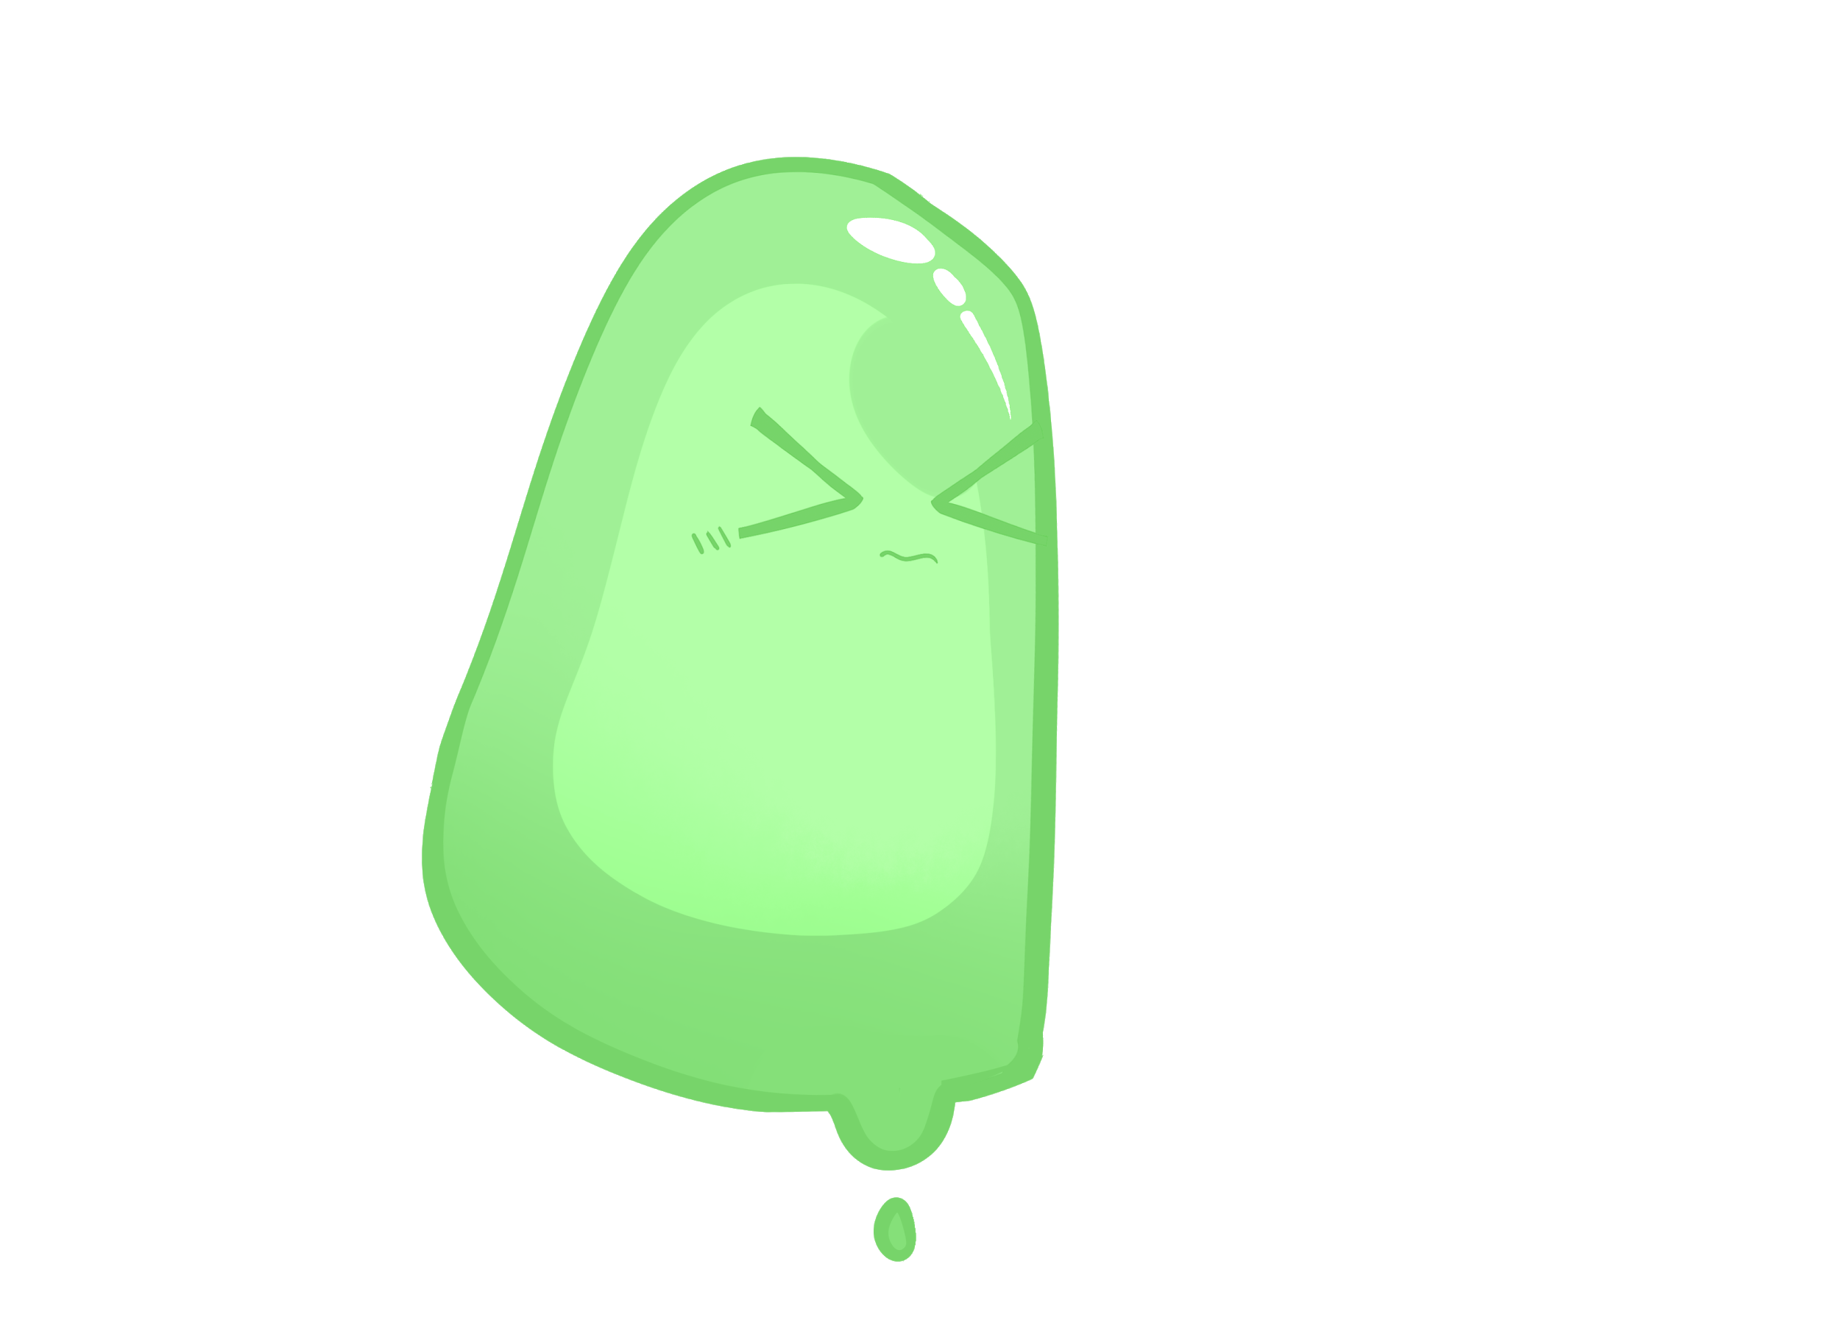
What is Tama?
A desktop pet and a productivity tool wrapped in one!
Deletion bin, macro editor, hotkey manager, and more.
Keep it fed and happy.
Toss it around your screen.
Find Tama here: https://github.com/just-drive/Tama

Slide 4

Tama’s Features - Milestone 1
Basic Needs System and Extensibility
Hunger, Happiness, Sleepiness
Feed him files to sate his unending hunger
Interact with him to keep him happy.
Give him some rest when he looks tired.
Extensible design
Module based design focus should allow
developers to easily add new functionality

Slide 5

Tama’s Features - Milestone 2
Productivity Tools
Macro Recorder - Record and Emulate User Input
Hotkey Manager w/ Hotkey Chaining
Trash Bin for Files - Permanent Deletion
Clipboard Extension - Manage multiple copied and pasteable files and rotate through the queue with hotkeys
Grab a Window with Tama to pin it to the front of the screen.

Slide 6
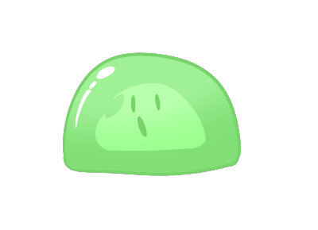
Tama’s Features - Milestone 3
GUI Polishing and Release
Give Tama a dynamic physics body.
Implement visual emotions and basic animations
Bug Fixing and Feedback Implementation
Expose an animation API for developers.
Build for Linux and Mac
Release v1.0

Slide 7





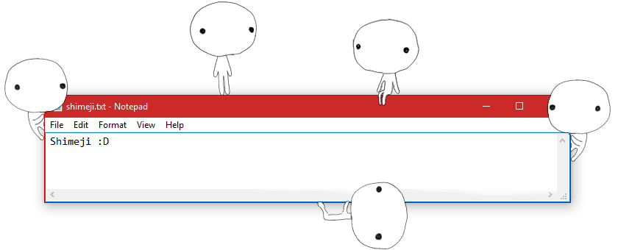
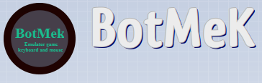
Tama’s Competitors
Tama is poised to be more well rounded than these guys.

Slide 8
Competitor Type 1: Macro Editors
Records keypresses and mouse movements for use later.
Runs these macros in the background.
Price ranges from ($0 to $200)

Slide 9
Competitor Type 2: Chat Bots
Creates a smooth interface where you can respond and talk to bots
Add the template to websites and applications to target your needs.
Price ranges from ($50 to $500)

Slide 10
Competitor Type 3:Online Pet
Runs as a small avatar on the side of your screen
Has cute animations whenever you click on it or interact with it
Pricing tends to be free

Slide 11
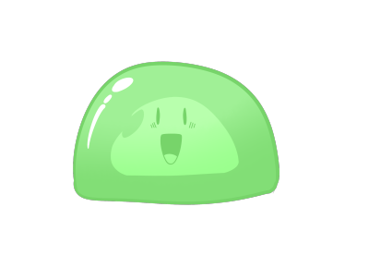
How is Tama is Better Than The Competition?
Combination of other programs’ aspects, even if simplified a little.
Record and edit macros.
Tama can be directly interacted with as an avatar that will be placed on the user’s desktop.
The avatar expresses itself with dynamic emotions.
Access to main variables makes Tama easy to modify.

Slide 12

The Risks that Tama Faces
These issues must be taken into consideration
Testing-Driven Design methodology (TDD) (80% Risk)
Problem: No experience w/ TDD
Solution: Make sure the team has a clear picture of project requirements to test.
Deployment on macOS, Windows, and Ubuntu. (50% Risk)
Problem: Differences between OS/Compatibility
Solution: If there is a time-restriction, Tama will be only deployed to Windows.
Learning new libraries. (20% Risk)
Problem: Failure to properly learn and implement these libraries may result in feature creep
Solution: Sprint planning must take into account
library learning time

Slide 13
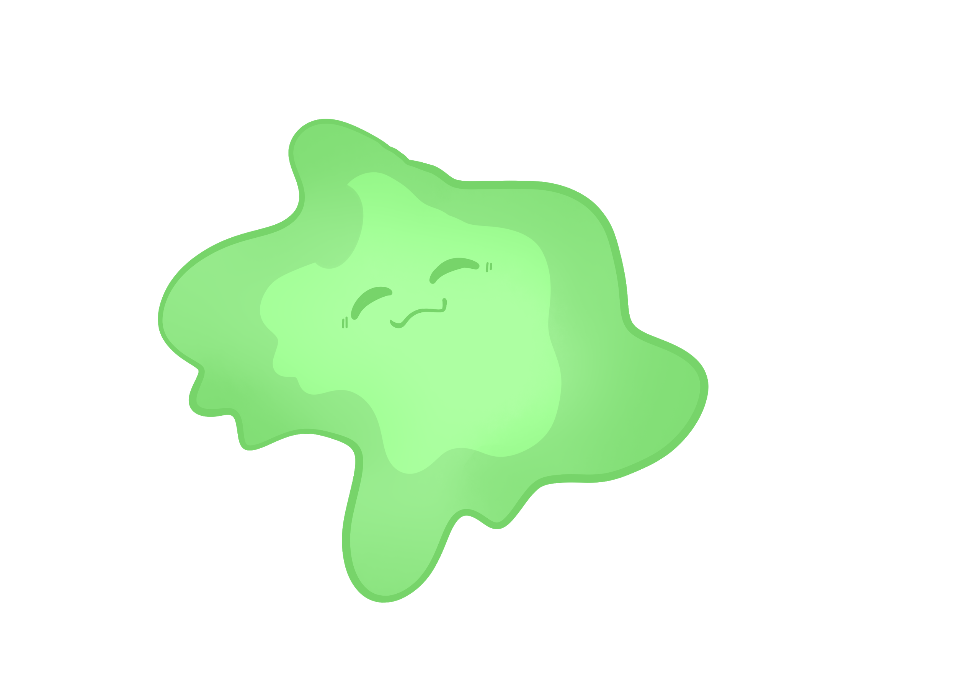
Who is Tama Meant For?
Tama is useful for anyone and everyone
Customers: CSE 3311 Class
Potential Users:
Beginner desktop computer users
Children
Elderly
“Power users”- knowledgeable users looking for an easy way to execute common desktop tasks.

Slide 14
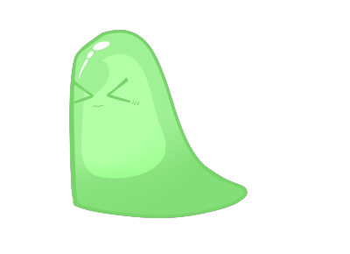
Summary
Enjoy Tama as a desktop pet, productivity tool, or both!
Little competition - No one does it all.
Simple for beginner computer users
Useful for intermediate/advanced users
Minimal GUI stays out of your way.

Slide 15
References
“Home.” AutoIt, 2019, www.autoitscript.com/site/.
Razvan Serea, News Reporter, Neowin ·. “TinyTask 1.77 [Update].” Neowin, 1 Nov. 2019, www.neowin.net/news/tinytask-176/.
AutoHotkey, www.autohotkey.com/.
“Macro Recorder.” Jitbit.com, 2021, www.jitbit.com/macro-recorder/.
“Shimeji-Ee Desktop Pet.” Kilkakon.com - Shimeji-Ee Desktop Pet, kilkakon.com/shimeji/.
“Emulator Game Keyboard and Mouse!” BotMek, botmek.com/.
“ChatBot Visual Builder - A Better Way of Building Chatbots.” ChatBot, 2021, www.chatbot.com/features/visual-builder/.
Notes:
https://www.google.com/url?sa=i&url=https%3A%2F%2Fwww.autoitscript.com%2Fsite%2F&psig=AOvVaw0jqU0ssh59bQvOm4MN9qEc&ust=1612317391367000&source=images&cd=vfe&ved=0CA0QjhxqFwoTCLDL876Myu4CFQAAAAAdAAAAABAD
https://www.neowin.net/news/tinytask-176/
https://www.autohotkey.com/
https://kilkakon.com/shimeji/
https://www.chatbot.com/
https://botmek.com/

Slide 16
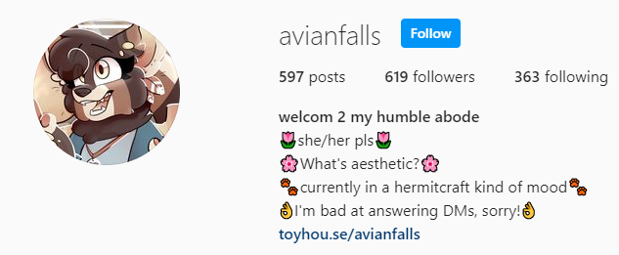
Tama Artwork done by @avianfalls

Slide 17
Q/A

Slide 18


